Slide 1


DEGTrend: End-to-End Multi-Condition RNA-seq Analysis
Michelle Kojekine
Dr. Asaf Marco
17.02.2026

Slide 2
Workshop Goal
By the end of this session you will be able to:
Run DEGTrend independently
Choose the correct workflow (Option 1 / 2 / 3)
Understand required input structure
Interpret statistical trend extraction
Generate publication-ready outputs
Avoid common structural mistakes
This session focuses on logic, not installation.

Slide 3
What DEGTrend Does?
PCA plots
RLE plots
Preprocessing & Quality Control
  Differential expression analysis using DESeq2
Expletory Analysis
  Heatmaps of expression for selected overlaps
  Venn diagrams
  Trend plots
  Remove lowly-expressed genes
  Map gene IDs to gene symbols
  Normalization
  Remove unwanted variations using RUVSeq
  Remove outliers
  Identify shared vs. unique DEGs across conditions
  Cluster genes by directional change across conditions
Differential Expression Analysis
Input
Output
Normalized / Filtered counts data
Combined DEGs table
Extended results table

Slide 4
What You Need Before Starting
R installed on your computer (version 4.4 or higher).
  If you don’t have R: download it from https://cran.r-project.org/ (or https://cloud.r-project.org).
  Required R Packages Installation (as detailed in the git)
Your data files ready (DEG tables, count matrix, sample info, etc.).
  Example data for DEGTrend is available in the following Google Drive folder:
  https://drive.google.com/drive/folders/1HgtBbxDIWFP47Bp6M3hT0WvLkLlPJlVE?usp=sharing
A folder where you want all results to be saved (the program will ask you for this).

Slide 5
Required R Packages
install.packages("BiocManager")
install.packages(c("shiny", "ggVennDiagram", "plotly", "DT", "miniUI", "sf", "ggupset", "readxl", "ggplot2", "RColorBrewer", "circlize", "viridis", "reshape2", "openxlsx", "VennDiagram", "dplyr", "tidyr", "stringr", "matrixStats"), dependencies = TRUE)
BiocManager::install(c("DESeq2", "RUVSeq", "edgeR", "rtracklayer", "ComplexHeatmap", "Biobase", "SummarizedExperiment"), dependencies = TRUE, update = TRUE, ask = FALSE)

Slide 6
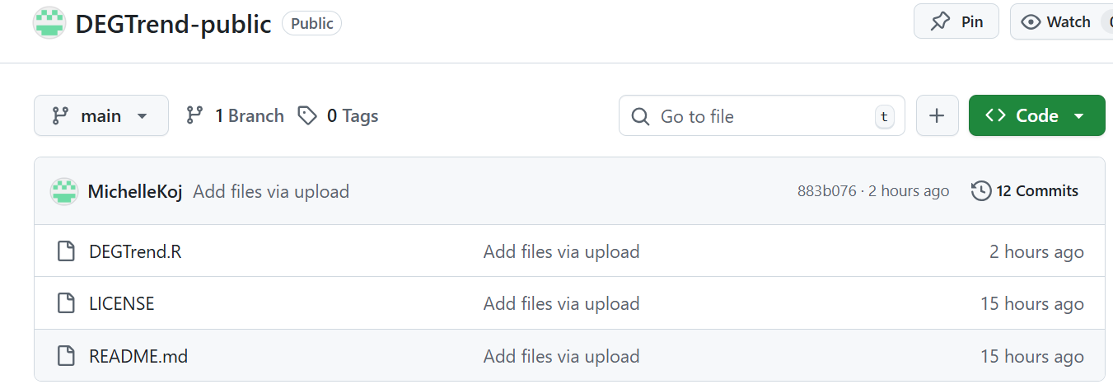
Downloading DEGTrend.R from GitHub
We will download only the main script file: https://github.com/MichelleKoj/DEGTrend-public

Slide 7
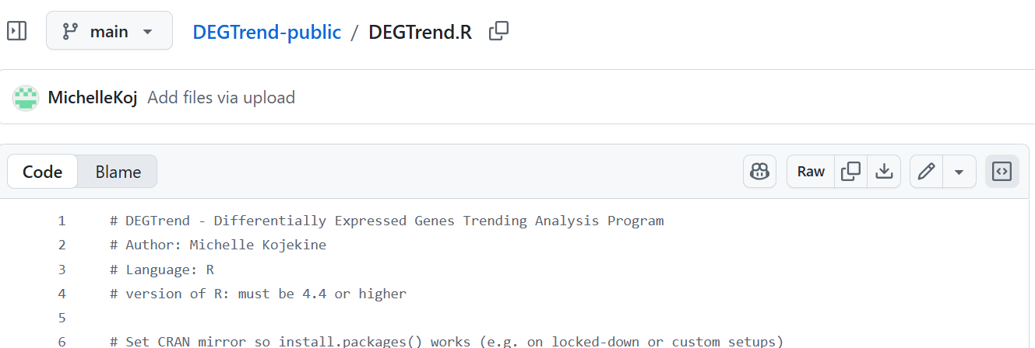
Save it inside your working folder
(for example):
Windows: C:/R_workshop/
Mac: ~/Desktop/R_workshop/

Slide 8
Run DEGTrend.R (for example):
setwd("<your full path> ")
source("DEGTrend.R")
Or:
source("<your full path>/DEGTrend.R")

Slide 9
Step 1: Output Directory
The program first asks:
“Please provide a directory to save all exported files…”
This folder will contain all outputs
The folder will be created automatically if it does not exist
Use one folder per experiment

Slide 10
Main Menu Overview
After selecting the output directory:
[1] Load DEGs tables and analyze
[2] Process count files and perform differential expression analysis
[3] Load genomic data tables and analyze
[4] Quit
Each option corresponds to a different analysis mode.

Slide 11
Choosing the Correct Option
Option 1
Use when differential expression analysis was already performed.
Option 2
Use when you have raw count data and want DEGTrend to perform DE analysis.
Option 3
Use when integrating genomic differential data (e.g., methylation, ATAC, ChIP).

Slide 12
Start from Option 2
  Import gene count data, assign sample conditions
  Remove lowly-expressed genes
  Map gene IDs to gene symbols
  Normalization by PCA & RLE analysis
  Remove unwanted variations using RUVSeq
  Remove outliers by hierarchical clustering
  Perform differential expression analysis using DESeq2.

Slide 13
Process data and perform differential expression analysis
You will choose:
[1] Process count files and perform differential expression analysis
  You can provide either a count matrix file or a folder of count files, plus a sample info table if you have one.
[2] Perform differential expression analysis without processing count files
  You provide a count matrix and a sample info table (no raw count files).
The program will run the analysis (e.g. DESeq2-style) and then you can export results and generate plots.

Slide 14
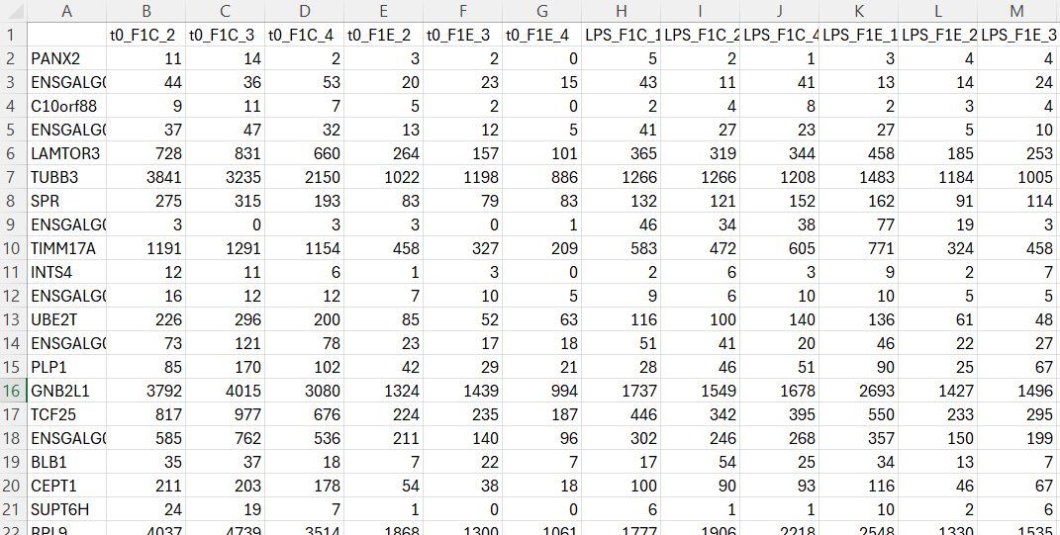
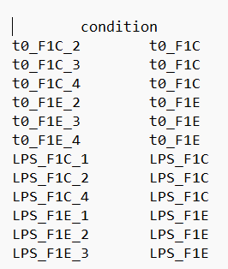
Option 2: Input Requirements
A count matrix
A sample information table
Annotation File (Optional): Used for converting gene IDs to gene names.

Slide 15
Independent Work – Option 2
Run DEGTrend.R (source(".../DEGTrend.R") in R)
Enter the output folder path when asked
Select: [2] Process count files and perform differential expression analysis
And then: [1] Process count files and perform differential expression analysis
Follow the on-screen prompts
After completion: find your results in the output folder and its subfolders
  results/
  PCA_RLE/
If you need help at any point, raise your hand and I will come to you.

Slide 16
Outputs from Option 2
After DE analysis, DEGTrend generates:
PCA and RLE plots (both in svg & png formats)
hierarchical clustering plot
normalized counts (one by RUV if was done, and one by DESEQ2)
DEG tables (one for each comparison)
Two consolidated files with pairwise comparisons:
  "all_DEG_results.csv“ (→ can be used in option 1)
  "mega_results.xlsx"

Slide 17
From Comparisons to Trends
  Now we can:
  Identify shared vs. unique DEGs across conditions
  Cluster genes by directional change across conditions
  By:
  Heatmaps of expression for selected overlaps
  Venn diagrams and Upsets
  Trend plots for comparisons and target genes.

Slide 18
Option 1: Load DEGs tables and analyze
Use this when you already have:
A DEGs file
  Required columns:
  baseMean, log2FoldChange, lfcSE, stat, pvalue, padj, comparison, Gene
  The Gene column should contain gene names/IDs.
  comparison should describe the comparison:
  “ConditionA vs ConditionB”
A counts file (raw or normalized)
A coldata file (sample info)

Slide 19
Load DEGs tables and analyze
After loading the files, you will choose between:
Automatic analysis
Manual analysis
Both use the same DEG results.
The difference is in filtering control.

Slide 20
AUTOMATIC ANALYSIS MODE
The program will:
  Apply default padj threshold (0.05)
  Use predefined direction logic
Generate:
  Heatmaps (by scaling: log2, z-score; by type: combined, up/down)
  Venn diagrams and UpSet plots (PNG, SVG) and count/gene tables
  Trending pattern plots and data
Notes:
לוקח מלאאא זמן!

Slide 21
MANUAL ANALYSIS MODE
Manual mode = same inputs and same core logic, but you choose thresholds + exactly what to generate (instead of the predefined defaults).
Manual menu includes:
Check genes of interest
  Input: comma-separated gene list or a file path (csv/tsv/txt/xlsx; first column is used)
  Output: gene_search_summary.csv + per-gene plots by comparison
Generate heatmaps (default / customized): you choose grouping column from coldata, scaling (log2 or z-score), color palettes, padj threshold and the comparisons: all (default) or selected intersections (custom)
Create Venn + UpSet: you choose split up/down (or not), padj threshold, which comparisons to include
Generate trend plots: you choose default patterns or split up/down (or not), padj threshold, which comparisons to include + genes list (manual selection)

Slide 22
Independent Work – Option 1
Run DEGTrend.R (source(".../DEGTrend.R") in R)
Enter the output folder path when asked
Select: [1] Load DEGs tables and analyze
Load:
  DEGs table (must include at least: log2FoldChange, padj, comparison, Gene)
  counts matrix (raw or normalized)
  coldata (sample info)
Choose Manual analysis
Try search 2–3 genes you care about, Venn and UpSet, Heatmap and Trend plots for two comparison sets
If you need help at any point, raise your hand and I will come to you.

Slide 23
QUICK REVIEW: OPTION 3 (Genomic differential data)
Integration of RNA-seq with different omics data types (ATAC/ChIP/methylation…)
What Option 3 asks for first:
  Path to genomic results file (csv/tsv/txt/xlsx)
  Required columns (minimum):log2FoldChange, padj, comparison, Gene
Option 3 features includes:
  Genes of interest (same behavior: list or file; outputs summary CSV + plots)
  Heatmap (threshold-based)
  Venn diagrams and Upsets
Option 3 does not use counts/coldata-based expression grouping like Option 1/2 -it’s driven by the genomic results table.

Slide 24
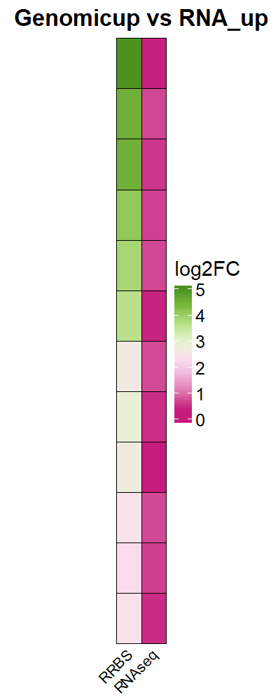
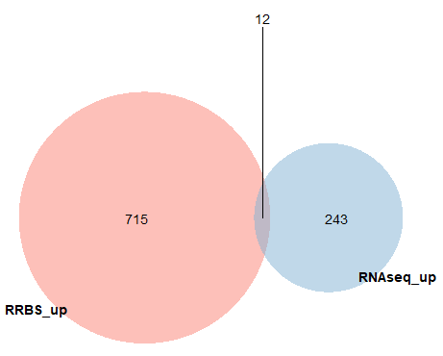
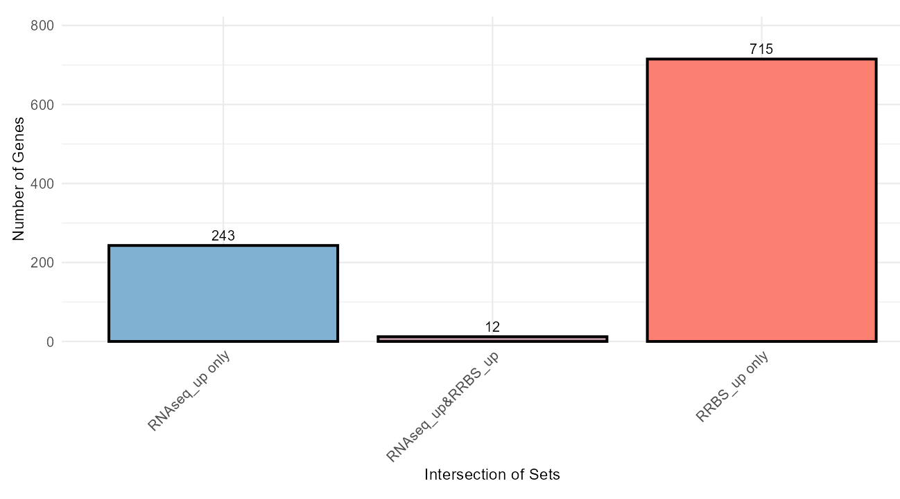
Option 3- example running

Slide 25
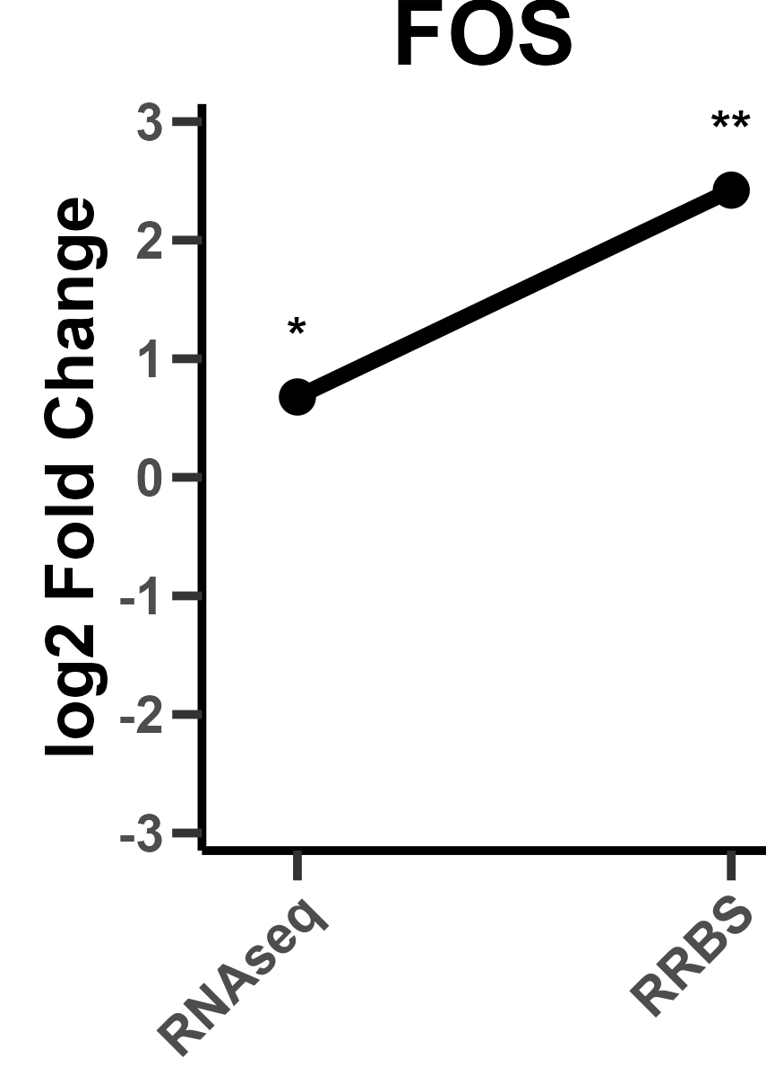
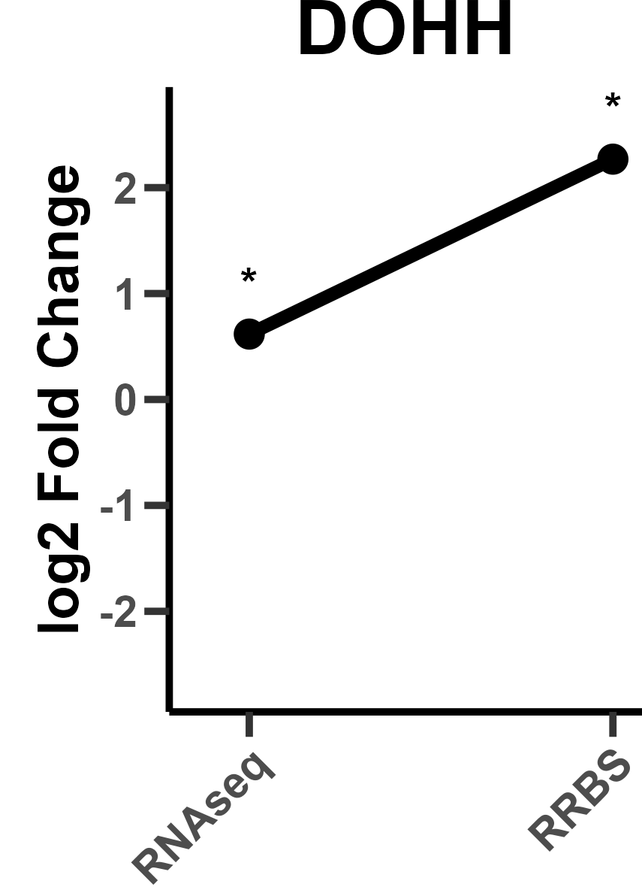
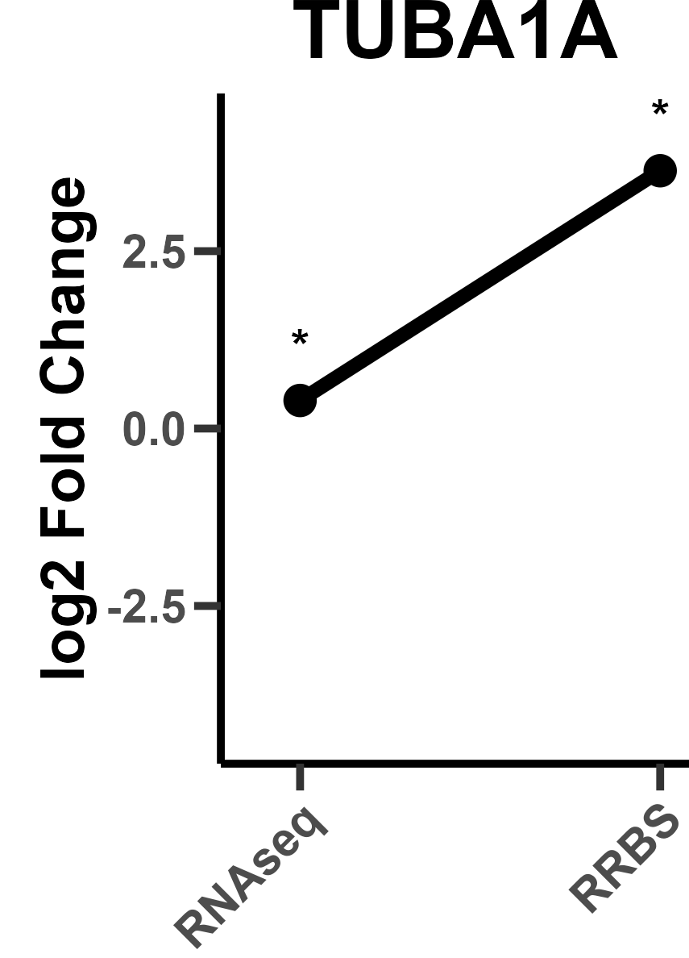
Option 3- example running

Slide 26
Questions? Feedback? Ideas?
Whenever DEGTrend is updated, please download the latest version from GitHub and replace your local copy to ensure you are using the most up-to-date and stable release.
https://github.com/MichelleKoj/DEGTrend-public
If you encounter:
Errors or unexpected behavior
Missing features
Suggestions for improvement
Ideas for new functionalities
Or anything that can make DEGTrend better
Please feel free to contact me.
Email: michelle.kojekine@mail.huji.ac.il.
I welcome feedback- it helps improve the tool and make it more useful for the community.

Slide 27
Checking R Version
Check version:
  R.version.string
Or:
  sessionInfo()
Old R versions may cause package failures.

Slide 28
Updating R
R does NOT update automatically.
Windows:
Download from cran.r-project.org
Install latest version
Mac:
Download R for macOS
Install normally
Restart computer after installation.

Slide 29
Updating Packages
Check outdated packages:
  old.packages()
Update all:
  update.packages(ask = FALSE)
Update Bioconductor:
  BiocManager::install(update = TRUE, ask = FALSE)
Restart R after updating.

Slide 30
Mac-Specific Note (Important)
If Bioconductor package installation fails with:
clang error
Open Terminal and run:
xcode-select --install
This installs required developer tools.
Most Macs already have it.

Slide 31
Common Errors
Typical issues:
Wrong working directory
Wrong file path
Package not installed
Case sensitivity (Mac)
Most problems are environment-related.
Not programming-related.

